Slide 1

UFO SIGHTINGS IN US -A VISUAL ANALYIS
Worked by
Akhil Sreehari
Gopikrishnan Pararath Radhakrishnan
Sanket Sinha
Kashish Kothari

Slide 2

Total Sightings of UFO in US
UFOs are reported to be sighted in the US as early as 1910.
The recordings of such occurrences started since 1998 and there are around 65,000 such sightings reported till 2014

Slide 3
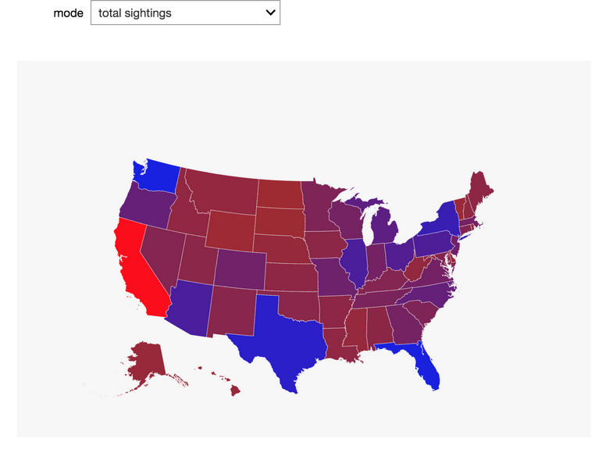
Graph depicting UFO sightings in US

Slide 4
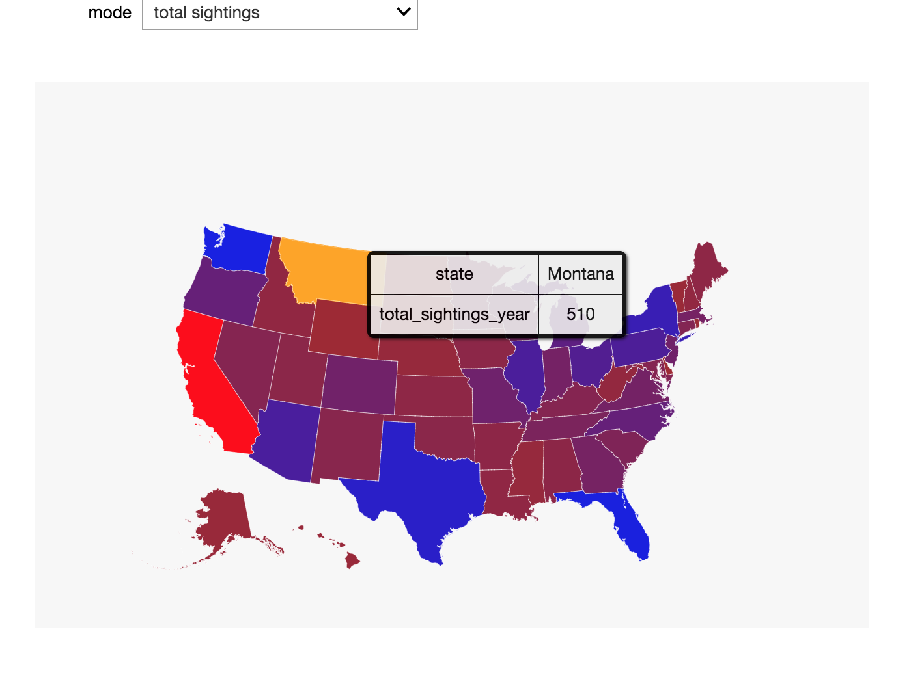

Slide 5
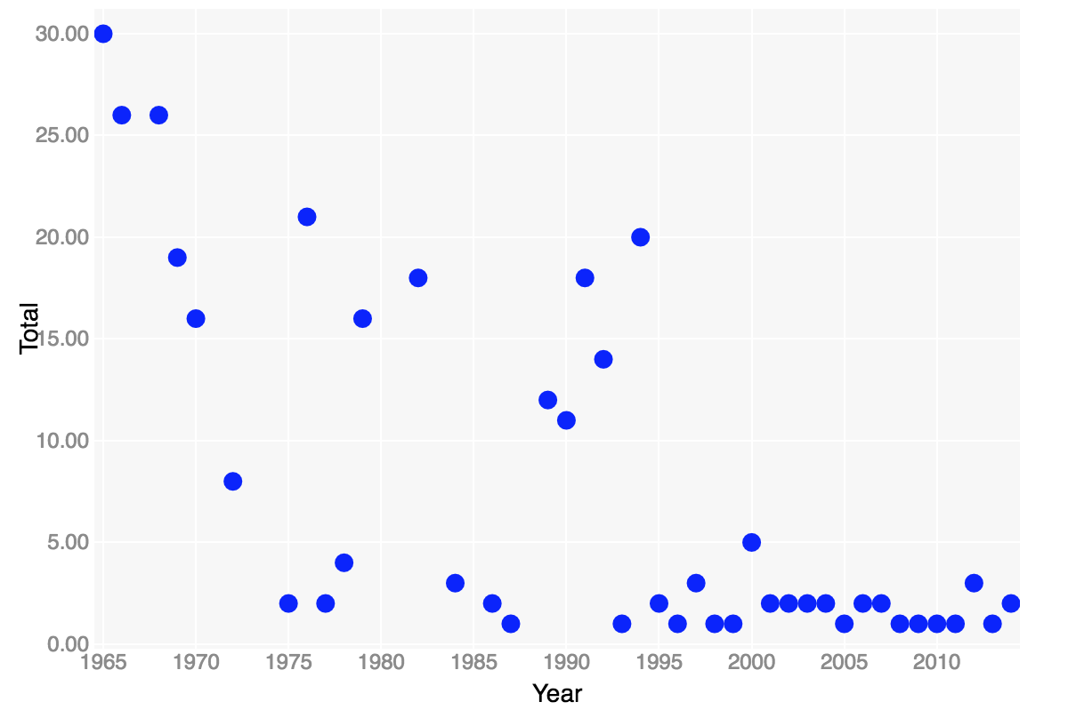

Slide 6
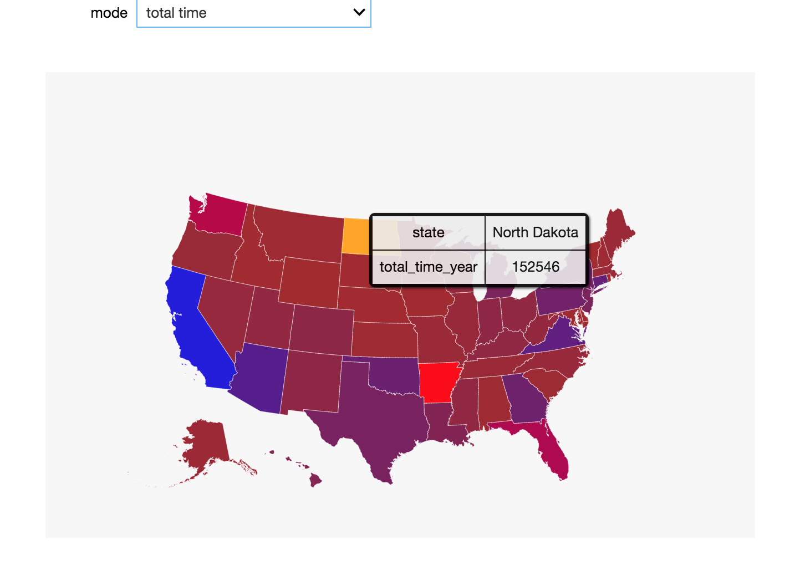
Graph depicting UFO’s duration

Slide 7
Analysis of data
We worked around with the data to find interesting trivias.
For example, sightings were largely recorded on 1st and 15th of every month.

Slide 8
UFO sighted in diff

Slide 9
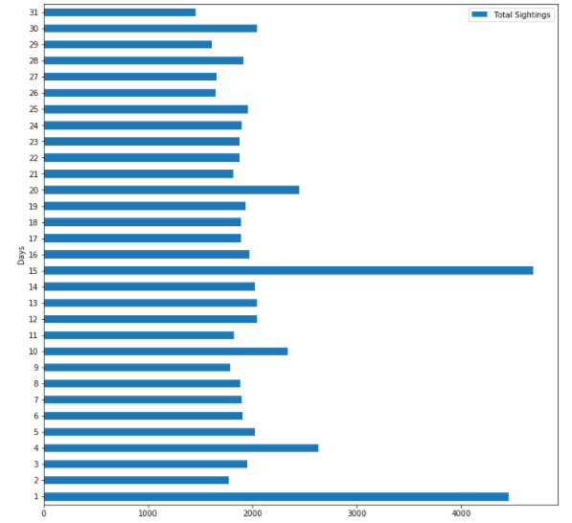

Slide 11
